Slide 1



Real Estate Broker
Application overview of the course CS253
By Group 14: Dangling Pointers

Slide 2


Team Members :
●
Chinmay Hiran Pillai (200298)
Shivang Pandey (200941)
Armeet Singh Luthra (200185)
Arth Banka (200191)
Vaishali Rawat (201080)
Utpal Dwivedi (211132)
Praveen Raj (210763)
Abhishek Kumar (210039)
Pravallika Mudunuru (220814)
Gaddam Shiva Leela (220392)
●
●
●
●
●
●
●
●
●

Slide 3
Acknowledgements
We would like to thank our instructor Dr Indranil Saha for giving us an opportunity to work on this project which was a great learning experience. We would also like to thank our TA, Vaibhav, who mentored and guided us throughout the course of the project

Slide 4

Take Control. Invest Smarter. Introducing the Real Estate Broker
We're thrilled to announce a groundbreaking real estate platform designed to simplify and empower property transactions!
Our Mission:
Connect Savvy Buyers and Sellers: We bridge the gap between property owners and seekers, eliminating the traditional hassles associated with buying and selling real estate.
Seamless User Experience: Our platform prioritizes user-friendliness, ensuring a smooth and reliable journey for everyone involved.
Security and Transparency: We take user safety and trust seriously, providing a secure and transparent environment for your real estate investments.
●
●
●

Slide 5

Why the Real Estate Broker?
●
Effortless Exploration: Discover curated property listings with detailed information– location, size, availability, and development potential. Find your perfect plot effortlessly.
Confident Transactions: Bid or auction your properties in a secure and transparent environment. Fair market pricing ensures you maximize your profit potential.
Stay Informed, Stay Ahead: Watchlist desired properties, receive bidding updates, and track market trends with dynamic pricing. Make smarter investment decisions.
Manage Your Portfolio: Easily access transaction history, track investments, and control finances with a dedicated portfolio section. Stay in complete control.
Potential users: 1. Property owners and sellers 2. Broker Administrators
●
●
●
●

Slide 6
Major Requirements: Functional Requirements
●
Registration & Login: Sign up for an account and log in to access the platform.
Home Page: Browse all available properties for sale.
Property Details: Each property page shows key details, along with the best buy and sell prices.
Trading Tools:
Market Orders: Quickly buy or sell a property at the current market price.
Limit Orders: Set buy/sell orders (bids) at specific prices for strategic acquisitions.
Order Book: See real-time buy and sell offers from other users.
Customization:
Watchlist: Add interesting properties for easy tracking.
Navigation Bar: Seamlessly access all sections - Portfolio, Watchlist, Funds, and Support.
Account Management:
Portfolio: View all your owned properties in one place.
Watchlist: Manage your shortlisted properties for future reference.
Funds: Monitor your available balance.
Add/Withdraw Funds: Easily add or withdraw funds to manage your investments.
Dedicated Support: Our Support Page provides contact information for any assistance you may need.
●
●
●
●
●
●

Slide 7
Major Requirements: Hardware and Software Interfaces
Hardware Interfaces:
Admin Terminal: A computer with internet access allows adding new properties after ownership verification.
Customer Access: Any internet-connected PC or mobile device can be used to access the broker application for buying and selling properties.
Mobile Payment Verification: Mobile phones are used to receive one-time passwords (OTPs) from banks for secure payment authorization.
Software Interfaces:
Frontend-Backend Communication: Data is securely transferred between the user interface and server using HTTPS and RESTful APIs.
Payment Processing: Payment APIs and bank software enable adding and withdrawing funds between the broker and bank accounts.
eKYC Integration: Customer identity and authorization for property transactions are verified using an eKYC API.
Database Storage: All property data is securely stored in an ACID-compliant database, ensuring data integrity and controlled access based on user roles

Slide 8

Key Design and Implementation Decisions
●
We have utilised a layered architecture for our system. It enabled us to develop all layers simultaneously without worrying the other layers and improved efficiency, prevented bottlenecks & saved development time
As for the coding up the software we have used Python language and used Django framework for our backend. We used ReactJS, CSS, bootstrap and javascript for the frontend.
The database system we opted for was MySQL since it provides a powerful, secure, fast, reliable and ACID-compliant relational database to store data that is easy to replicate.
We chose GitHub because it allows for tracking changes to our code (version control) using Git, while also making it easy for our team to work together on projects from anywhere (distributed accessibility and collaboration).
●
●
●

Slide 9

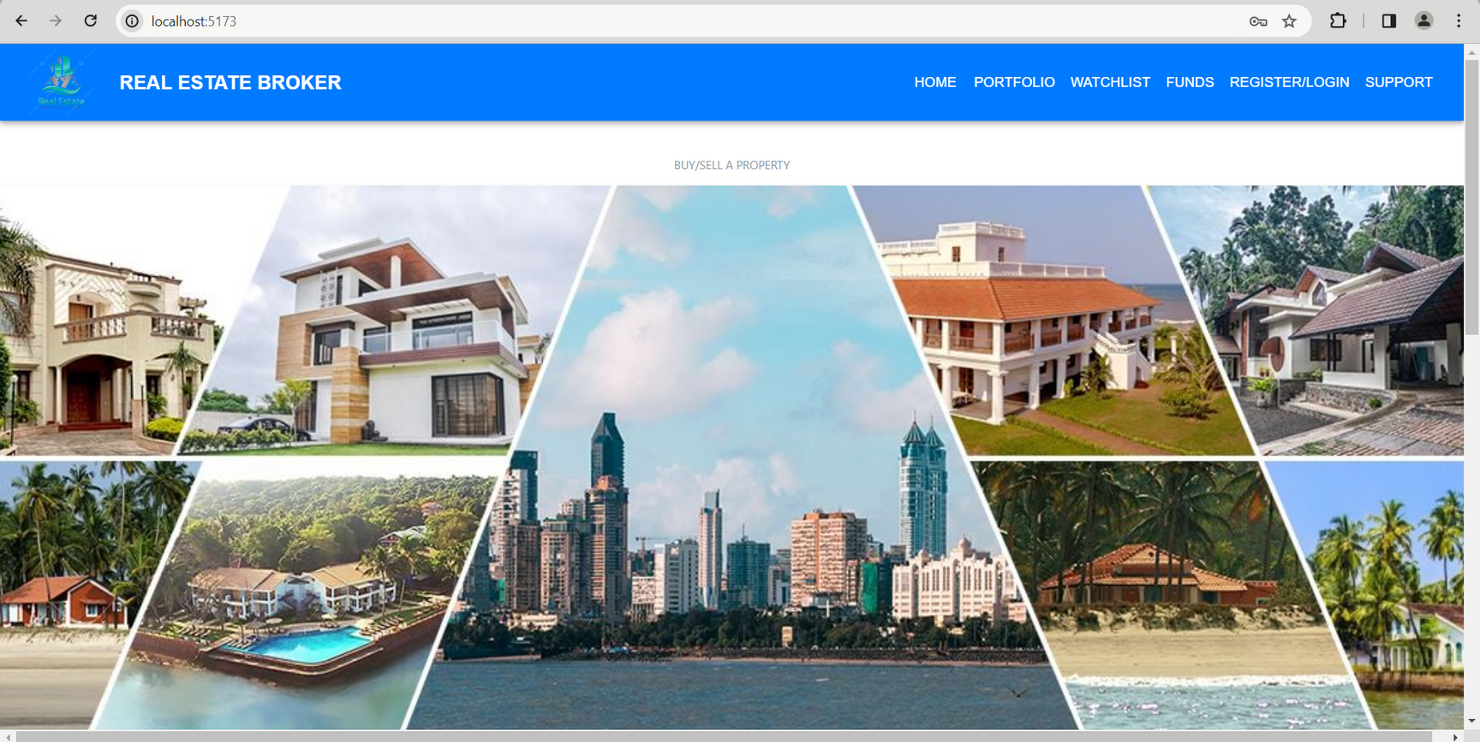
Application Demo

Slide 10

●
Future Development Plans
Add options to change password and implement forgot password
Adding a system that allows users to rate sellers and bidders.
Authorised Payment Gateway Integration: Enable secure transactions for property purchases.
PAN and e-KYC Authentication: Will enhance security and ensure user identity verification.

Slide 11

Lessons Learnt
●
Communication and Collaboration: Having a version control system (like Git) helps track changes, avoid conflicts, and allows for easy rollback if needed. Misunderstandings and a lack of clear communication can lead to delays, bugs, and rework. Defining clear expectations, using project management tools, and holding regular meetings are crucial.
The Value of Automation: Implementing automated tasks like building, testing, and deployment saves time and reduces manual errors.
Importance of Coding Standards: Consistent coding practices improve code readability, maintainability, and make collaboration easier.
Testing is Crucial: Unit testing, integration testing, and user acceptance testing (UAT) help identify and fix bugs before deployment.
Documentation Matters: Clear and up-to-date documentation on the project helps us understand the codebase better.
●
●
●
●

Slide 12
Contribution
Name % of work
Chinmay 20
Armeet 16
Shivang 16
Vaishali 10
Arth 9
Utpal 9
Praveen 7
Abhishek 7
Pravallika 6
Shivallela 0

Slide 13

Thank you!
We would be pleased to hear your feedback and take up any questions you may have!!!

